Slide 1

Data-Driven Storytelling Presentation:
ACCOUNT PERFORMANCE METRICS
AND
SALES TREND
BY
MOSES ADRIAN INDRIAS

Slide 2
INTRODUCTION:
Problem Statement
J.P. Morgan Chase & Co. is a leading global financial services firm that offers services and operates worldwide.
The company aims to analyze the account performance metrics over the last 5 years (2017-2021) and the factors contributing to its compound annual growth rate (CAGR) in unit sales. This includes identifying opportunities for further improvement.
Business Questions
• Examining the total unit sales for each account.
• Sum of Sales by Account Over 5 Years
• Top 5 Yearly Sales by Account
• Yearly Total Unit Sales
Average Unit Sales by Accounts.

Slide 3
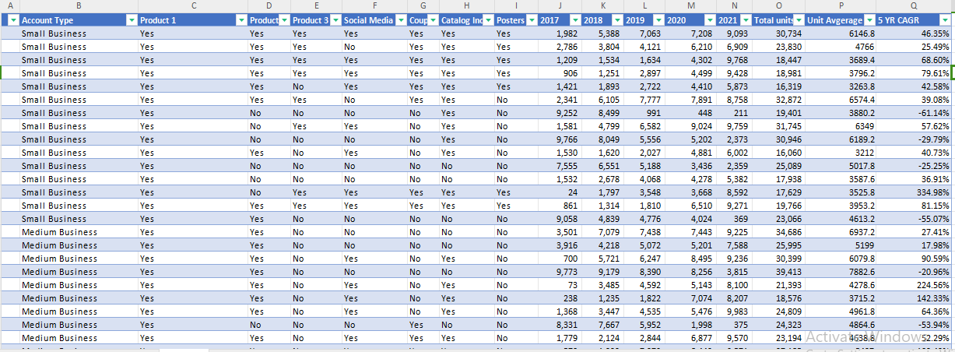
Utilizing Power Query in MS-Excel, transformed the data for improved organization, giving a more structured foundation for necessary analysis.
DATA MODELLING

Slide 4
DATA ANALYSIS & VISUALIZATION
Overview:
This sales data dashboard provides an analysis of sales performance across different account types over the past five years. It helps to identify trends and key contributors to sales, providing valuable insights for strategic decision-making.

Slide 5
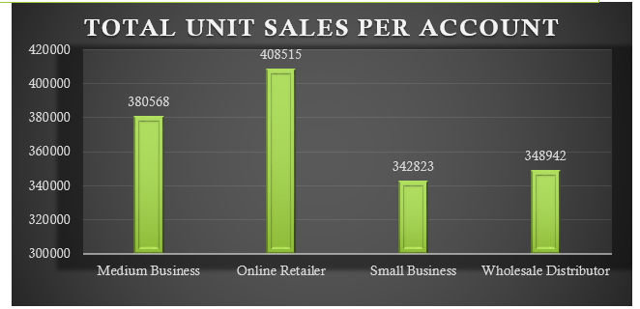
1. Total Unit Sales Per Account
Online Retailer: Leads with approximately 410,000 units sold, accounting for 27.7% of total sales.
Medium Business: The second-highest contributor with around 360,000 units sold, making up 24.3% of total sales.
Wholesale Distributor: Lower sales at approximately 310,000 units, contributing 20.9% to the total.
Small Business: Accounts for the smallest share with about 300,000 units sold, representing 20.3% of the total.

Slide 6
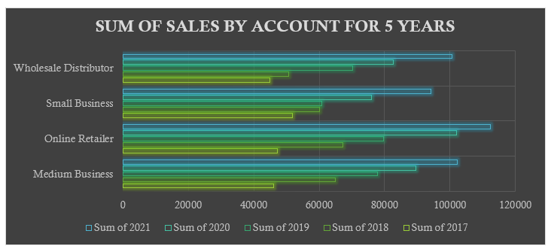
2. Sum of Sales by Account Over 5 Years
Online Retailer Performance: Online Retailers consistently dominate sales, leading across all five years.
Medium Business & Wholesale Trends: Medium Businesses and Wholesale Distributors show steady, stable sales with slight yearly fluctuations.
Small Business Sales Stability: Small Business sales remain comparatively lower but stable over the five-year period.

Slide 7
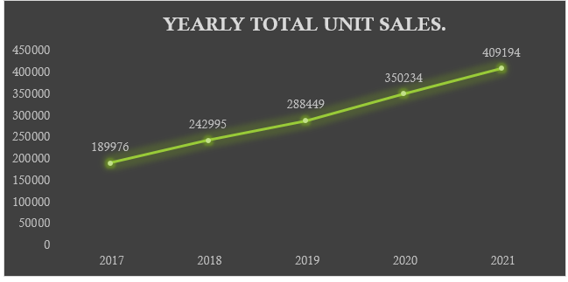
3. Yearly Total Unit Sales
Sales show a consistent upward trend from 2017 to 2021, indicating healthy growth.
The most significant growth in yearly sales occurred between 2019 and 2021.

Slide 8
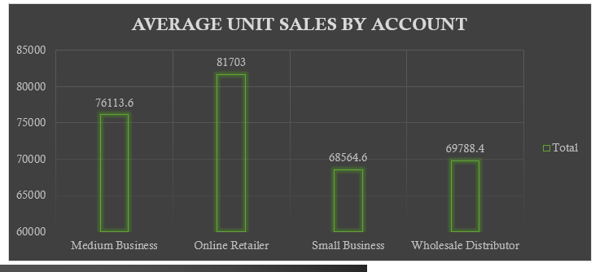
4.Average Unit Sales by Account
Market Dominance of Online Retailers: Online Retailers lead with the highest average unit sales at 81,703 units, underscoring their market dominance.
Medium Business Sales Comparison: Medium Businesses average 76,113 units, substantial but significantly lower than Online Retailers.
Similar Averages for Small Business & Wholesale: Small Business and Wholesale Distributor show similar average sales levels, around 69,784 and 67,984 units respectively.

Slide 9
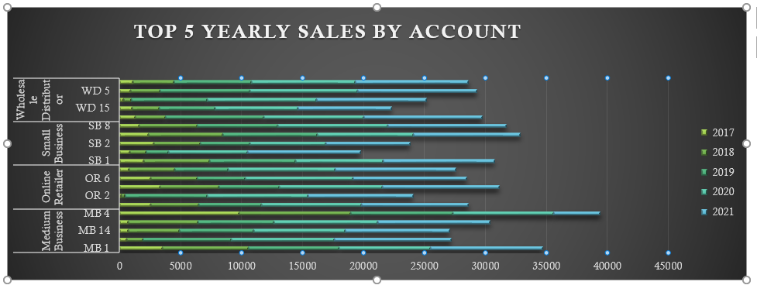
5. Top 5 Yearly Sales by Account
WD 5 (Wholesale Distributor) Dominance:
WD 5 consistently leads in sales, peaking at nearly 45,000 units in 2021.
OR 6 (Online Retailer) Growth:
OR 6 shows significant growth over the years, reaching about 40,000 units in 2021.
Strong Performance from SB 8 (Small Business):
SB 8 has seen remarkable growth, with sales climbing to approximately 35,000 units in 2021.
Fluctuating Medium Business Sales:
MB 4 and MB 1 exhibit fluctuating sales, with MB 1 showing a notable peak near 30,000 units in 2020.
Steady Decline in WD 15:
WD 15 saw strong early performance but shows a steady decline in recent years.

Slide 10
SUMMARY.
Efforts to increase small business engagement could unlock additional sales potential.
Monitoring and supporting high-performing accounts like WDS and SB21 could sustain and increase revenue streams.
The dashboard even reveals robust growth trends and highlights the importance of online retailers in the overall sales strategy. By focusing on high-performing accounts and exploring growth opportunities in medium businesses and small businesses, the organization can enhance its market position and drive future sales.

